Slide 1
Understanding Dementia Course
Supporting physical wellbeing
Mobility and risk of falls
Seeing and perceiving

Slide 2

Everyday Activities Session
Mobility and risk of falls
Washing and Dressing
Eating and Drinking
Continence
Night Disturbance

Slide 3
Physical difficulties in dementia
May be due to:
Direct damage to the parts of the brain involved e.g. in balance and walking; in judging distances; in recognising physical sensations; in differentiating night and day etc.
Memory loss and difficulties in thinking, organising, and planning, making it harder for the person to take care of their physical needs independently

Slide 4
I’m feeling cold
Planning & Problem Solving (executive function)
My foot is bleeding
Language
Memory
“Take 1 tablet four times a day an hour before eating”
Visuospatial
Attention/ Concentration
Notes:
Remembering to take medication
Concentrating long enough to do so
Planning (take 3 a day an hour before eating on an empty stomach)
Language – understanding instructions
Visuospatial – which way round do clothes go?
Visuospatial – dirty clothes – plus memory (when I last changed them)
Executive function – when anything goes wrong / nose bleed / coping after a fall /

Slide 5
Mobility and falls
Mobility problems and falls may be a core symptom of some types of dementia (e.g. Parkinson’s & Lewy Body dementia)
For some people changes in the way they perceive their surroundings may increase their risk of tripping or bumping into things
Someone with a memory problem may forget to use their walking stick or frame putting them at greater risk of falling
Infections , arthritis and joint problems can result in weakness and pain which in turn increases the risk of falls

Slide 6



Minimising risks
Keep warm
Good Lighting
Nightlights / movement sensor lights
Colours that define rather than merge
Sturdy furniture
Even flooring – no trip hazards (indoor & out)
Footwear & clothing

Slide 7


More tips to improve mobility and prevent falls
Are some household chores are now too risky?
Consider storing frequently used items in areas that avoid stretching or stooping / fit a letter box cage (balance with need for exercise)
Community alarms and monitors
Fit a key safe
Social Services can arrange for an Occupational Therapist
to visit and advise on safety equipment in the home
Contact the Health Hub
Call 0300 365 1234

Slide 8
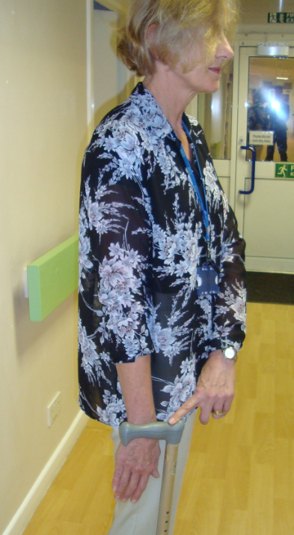
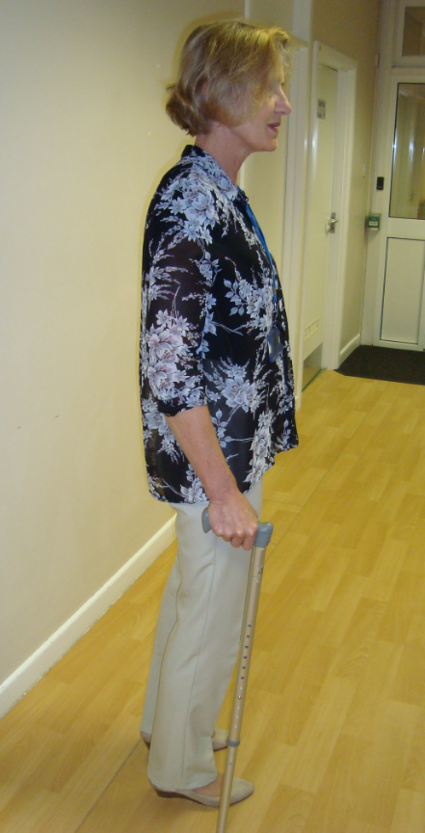
Correct height of walking stick
Handle of stick should be level with wrist bone
A stick that is too long will force the shoulder unnaturally high
A stick that is too short will force the user to stoop and is less likely to prevent a fall
Stick to be held on the opposite side to injured/painful leg
Check the rubber foot on the end of the stick for wear and replace as needed

Slide 9
Services
Falls Assessment Clinic
Physical checks / Vision / Hearing
Medication review – looking for reasons for falling
Community Falls Prevention Team
Home visits to carry out full falls risk assessment
Falls prevention plan
Referral to services that will help reduce risk of falling
Practical help to install equipment and rails when appropriate
Information on local opportunities for exercise and other falls prevention measures

Slide 10
Talking someone through getting up from a chair
Sometimes although a person might have the physical strength to get themselves up, they may need prompting as to the steps involved:
N.B. Think about the chair – is it the sturdy and right height for the person – does it have arms?
Prompt correct placement of feet (hip width apart – one foot slightly in front of the other)
If a mobility aid is needed position it so that it is available when the person is upright (but don’t let them try to pull up on it)
Shuffle forward in the chair
Place hands on the arms of the chair ready to push up
Rock forwards as you push yourself into a standing position

Slide 11
How to help someone up after a fall
Don’t try to get the person up straight away – calm them and yourself first
If there are signs of serious injury e.g. a broken bone, they may need to stay where they are. Make them as comfortable as possible and call an ambulance. Keep them warm while you wait for the ambulance
If they are not badly injured and feel they could get up, get two sturdy chairs and place one near the person’s head and one near their feet
It is important that the person who has fallen does the work, and that the helper should only guide lightly, helping the person to roll onto their side

Slide 12
How to help someone up after a fall
Help the person to kneel, if they have sore knees fold a towel and place it underneath as cushioning
Place one chair in front of the kneeling person
Ask the person to lean on the seat of the chair and bring one leg forward and put that foot on the floor
Place the second chair behind the person. Ask them to push up with their arms and legs and then sit back in the chair behind them. Guide them up and back into the seat – remembering not to lift them – they should be doing the work. Keep your back upright.
Let their doctor know that she/he has had a fall.

Slide 13
Eyes and Ears
Regular eye checks
Some opticians are skilled in assessing the vision of people with dementia.
Check that your relative is wearing the right glasses
Home eye tests
The Outside Clinic is a home visiting optician service for elderly people who are unable to go out without help. Sight test free of charge under NHS
Call 0800 60 50 40
Website www.outsideclinic.co.uk
Specsavers also offer a home eye test
Call 0800 198 11 32
Search online for Specsavers Home Eye Test
Ask GP to check ears
Ear infections and build-up of ear wax can upset balance
Outside clinic will also check hearing on request

Slide 14
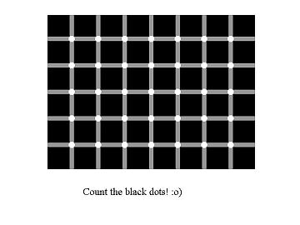
There are no black dots on this image, they are being produced by your brain.
Making sense of what we see

Slide 15


Slide 16
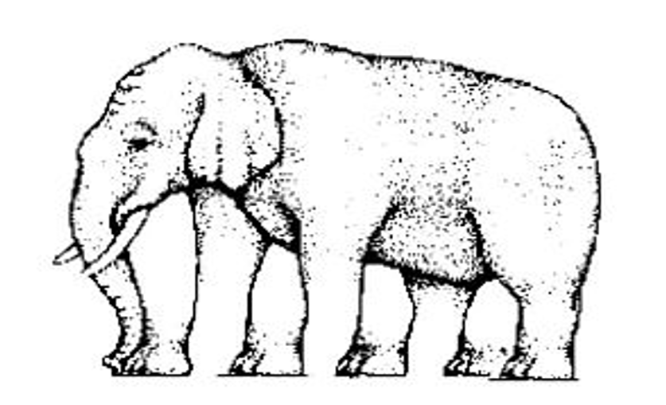
Count the legs

Slide 17
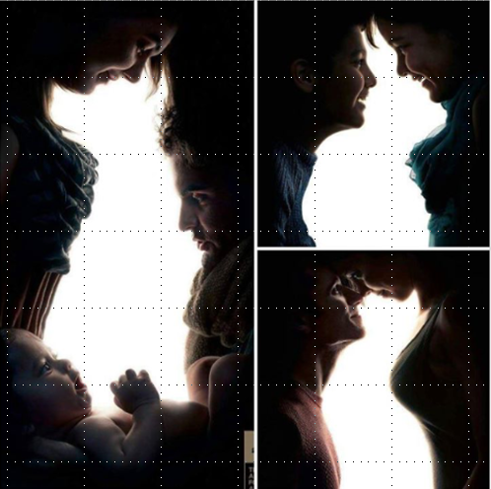
What do you see first – animals or people?

Slide 18
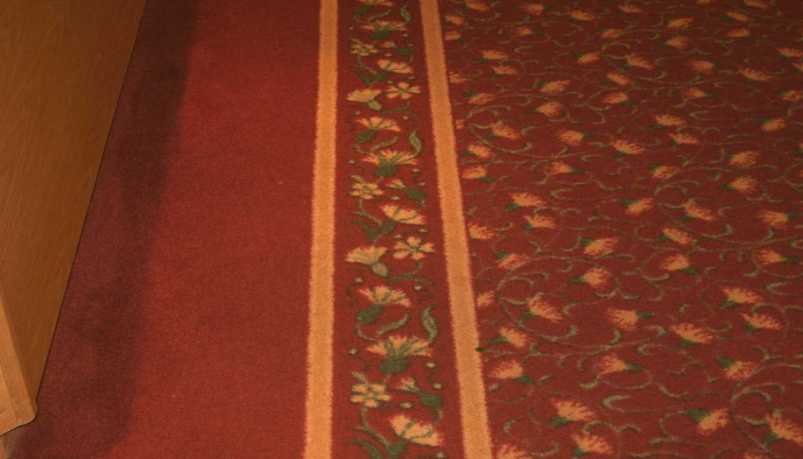
Carpeting with lines can look like steps

Slide 19
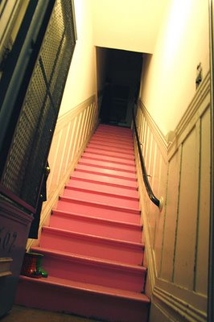
Upstairs or down?

Slide 20
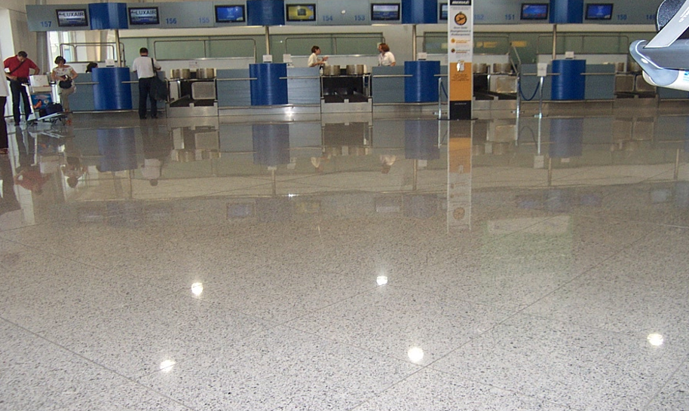
Does this floor look wet / slippery?
Notes:
People may be having difficulty coping with reflections and glare
+ reflections seen as obstacles

Slide 21
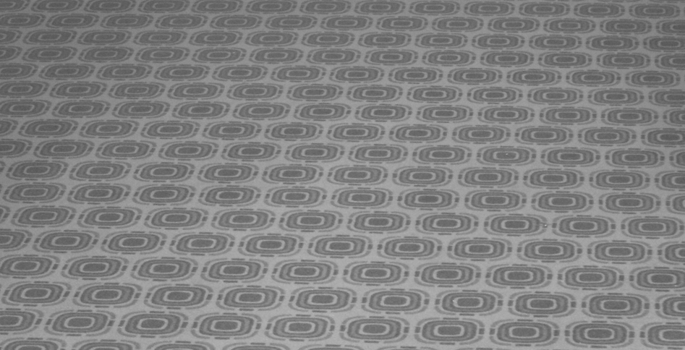
Poor choice of carpeting

Slide 22
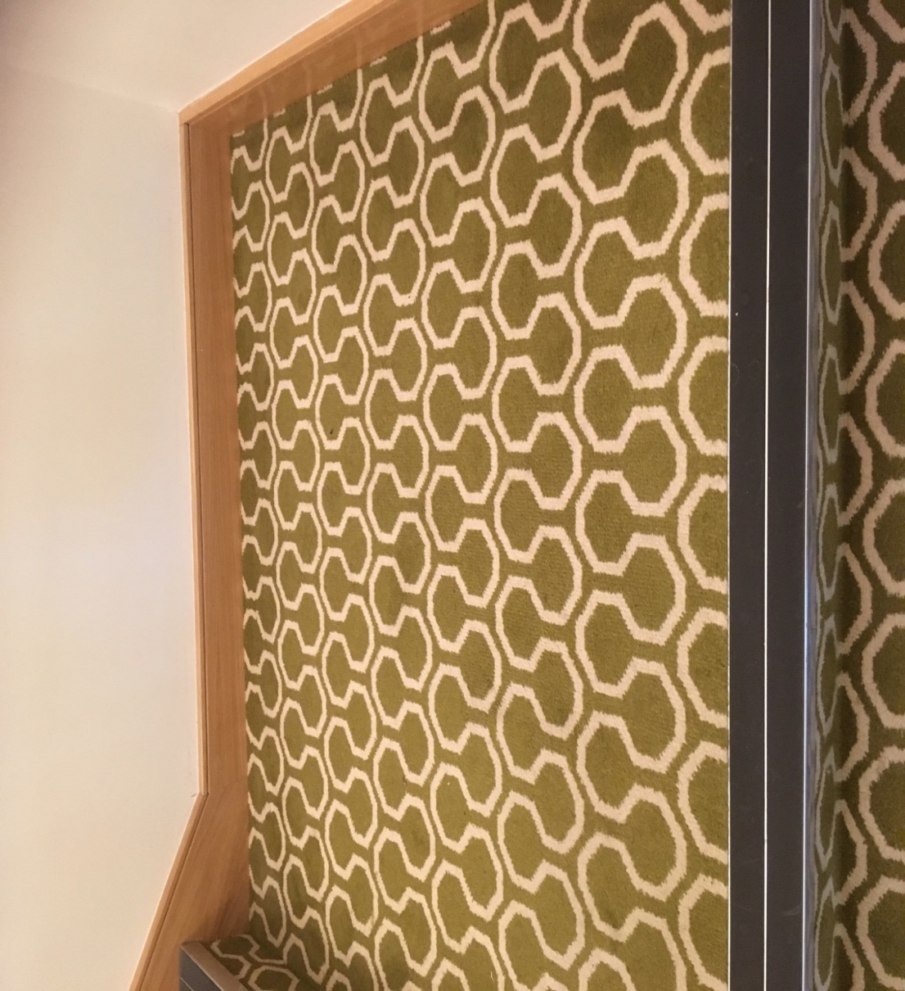

Slide 23
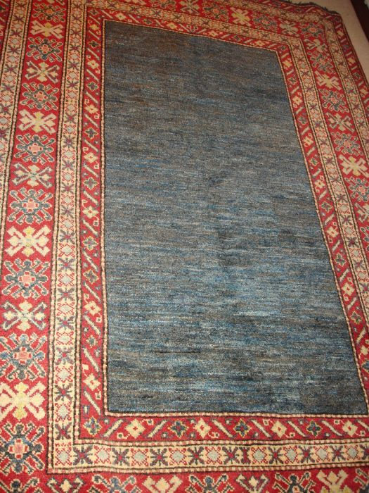
Steps? Black hole? Flowers?

Slide 24
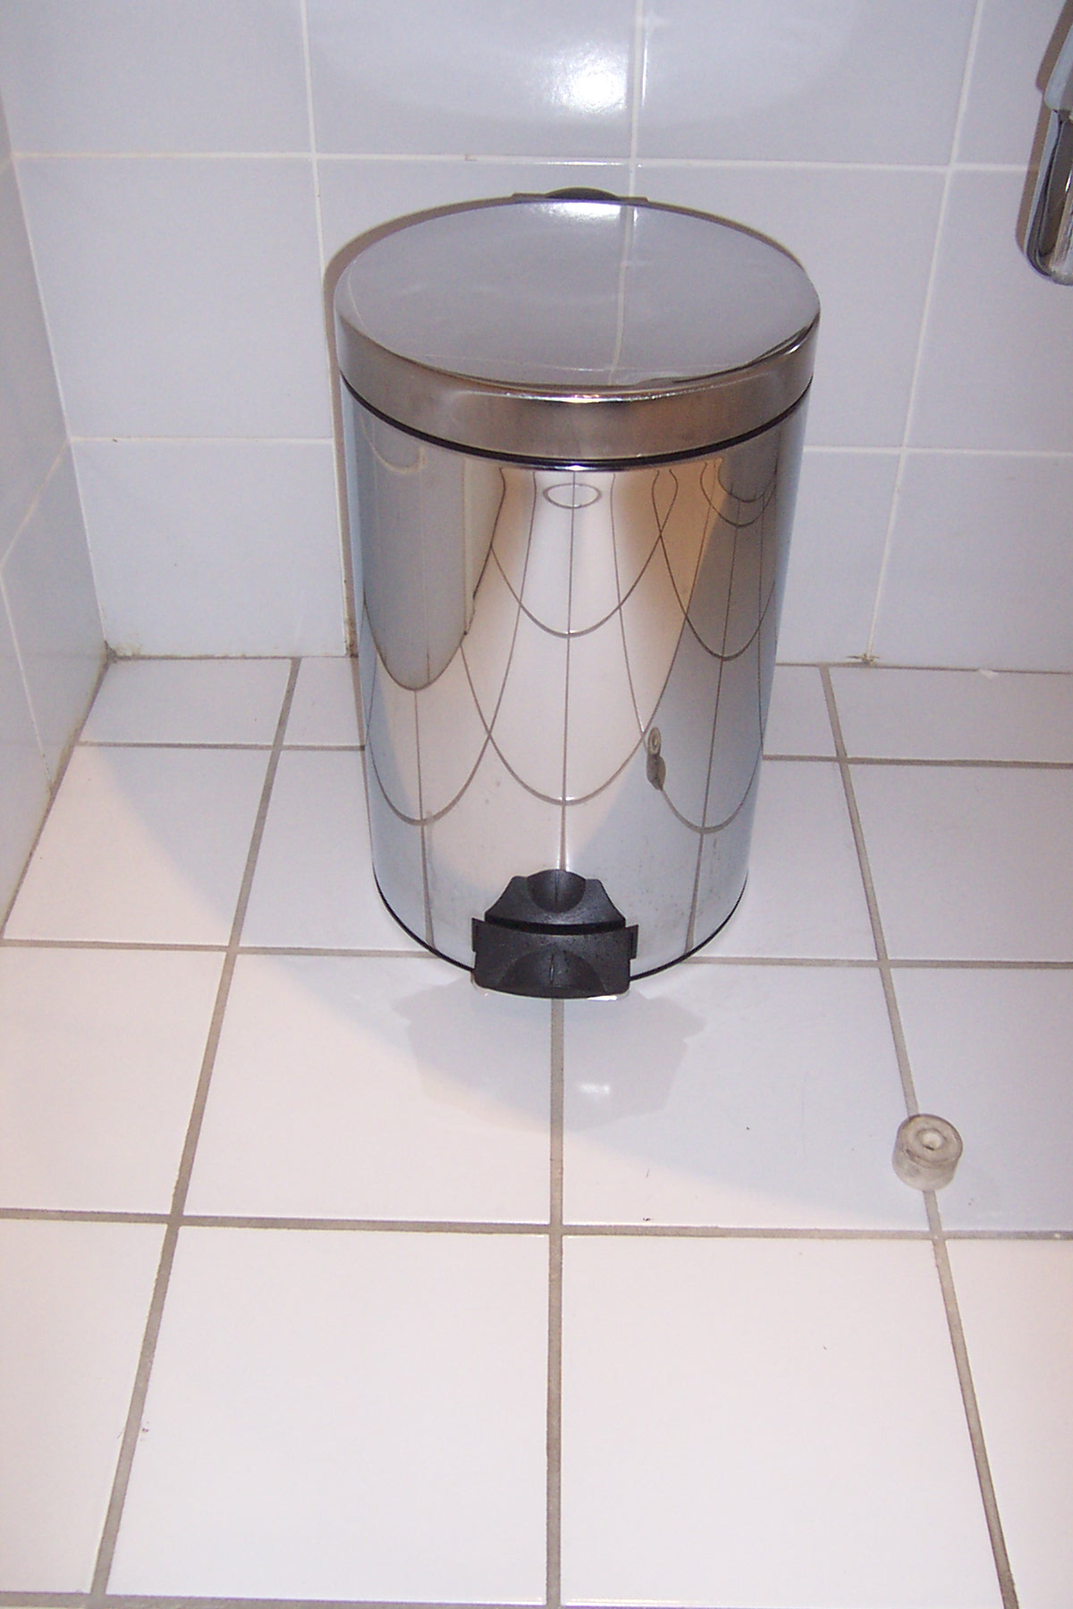

“There’s a mouse in the bin”

Slide 25
What do they see and how can you tell?
Pay close attention to how the person is reacting to their surroundings
Strong patterns/ shiny surfaces / reflections / poor lighting that casts shadows - all make visual mistakes more likely
Can you make any changes to lighting or decor to minimise confusion?
Notes:
PAY CLOSE ATTENTION TO ANY CLUES ABOUT HOW THE PERSON IS EXPERIENCING THEIR SURROUNDINGS
TRY TO ADAPT THEIR ENVIROMENT TO HELP MINIMISE ANY PROBLEMS CREATED BY THESE ALTERED EXPERIENCES
EG.
DARK SHADOWS SEEN AS HOLES TO STEP OVER
LIGHT PATCHES OF SUNLIGHT OR HIGHLY POLISHED FLOORS SEEN AS WET
CHANGES IN FLOORING COLOUR OR TYPE CAUSING:
INTERRUPTION IN FLOW OF WALKING
DISRUPTS BALANCE – RISK OF FALLS

Slide 26
Thank you
Time for a break…

